Slide 1

Basic Details of the Team and Problem Statement
Ministry/Organization Name/Student Innovation:
Government of Gujarat (Climate Change Department)
PS Code: SIH1362
Problem Statement Title:
Student Dropout Analysis For School Education
Team Name:Team Excel
Team Leader Name: Anushka Singh Institute Code (AISHE): U-0891
Institute
Name: MIT ADT - SOC Theme Name: Smart Education

Slide 2
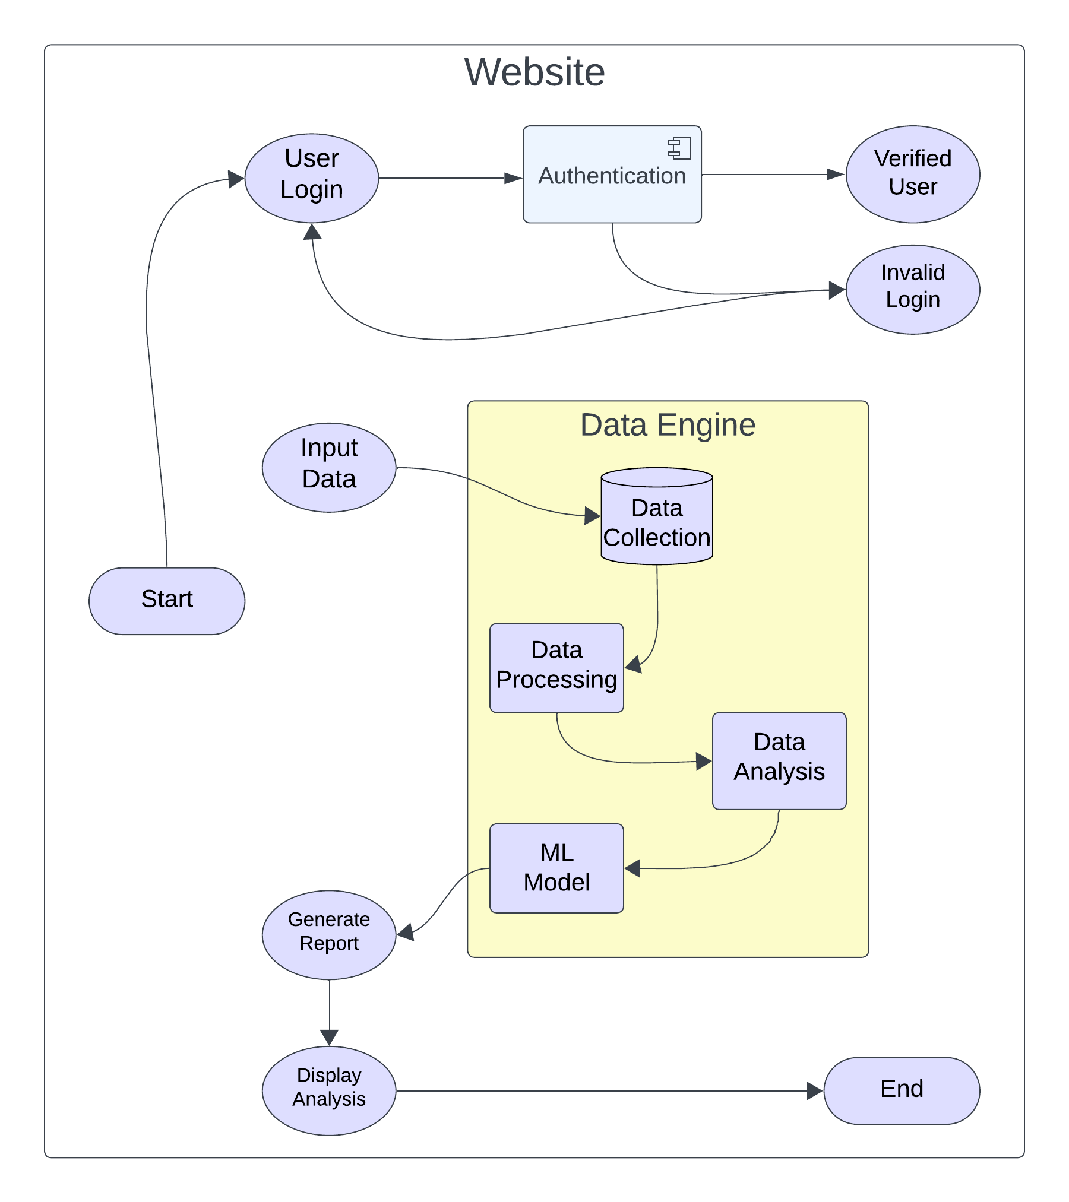












Idea/Approach Details
Flow Chart
Describe your idea/Solution/Prototype here:
The main goal of this project is to use the available datasets to undertake an extensive investigation of student dropout rates in schooling by having a software that can analyze the data on various parameter and provide factual information that can be used to bring chances in the current policies and rules of the government The analysis aims to provide insights into the following key aspects:
School Wise
Gender Wise
Area Wise
Caste Wise
Standard/Age Wise
We will have a Web Interface for the software which will monitor
the dropout rates and will make data-driven decision on the basis of above parameters.
Technology stack here:

Slide 3
Idea/Approach Details
Use Cases here:
-> Government can use the website to analyze dropout rates and patterns based on demographic
And social-specific factors.
-> School can access the data to identify trends in their dropout rates and take proactive measures to reduce them.
-> Parents can use the website to monitor their child’s performance, receiving alerts if their child is at risk of dropping out.
-> Educational institutions can use this website to plan interventions such as after-school programs, counseling services, or scholarship initiatives for specific group at the risk of dropping out.
-> Additionally, users have to provide the required input dataset and ensure that the website meets the needs of its intended users effectively.
Describe your Dependencies:
->User has to provide with proper dataset that fulfils the requirements of the algorithm.
->Improper datasets i.e. data inconsistency and redundancy in the dataset can lead to improper results.
->Dataset should be updated with time in order to get the most latest analysis.
->As it is going to be a web based software, there is a dependency on the internet connection.
Show stopper here:
->Government has to give valid dataset for further processing.
->Dataset should be provided on time to get analysis done on time.

Slide 4
Team Member Details
Team Leader Name: Anushka Singh
Branch: B.Tech Stream: CSE Year: III
Team Member 1 Name: Shruti karpe
Branch: B.Tech Stream:CSE Year: III
Team Member 2 Name: Manas Auti
Branch: B.Tech Stream:CSE Year: III
Team Member 3 Name: Aditya Kulkarni
Branch: B.Tech Stream: CSE Year: III
Team Member 4 Name: Jaydeep Jare
Branch: B.Tech Stream: CSE Year:III
Team Member 5 Name: Atharva Tupe
Branch: B.Tech Stream: CSE Year: III
Team Mentor 1 Name: Shahin Makubhai
Category : Academic Expertise : AI & Cloud Domain Experience : 4 Years

